Slide 1
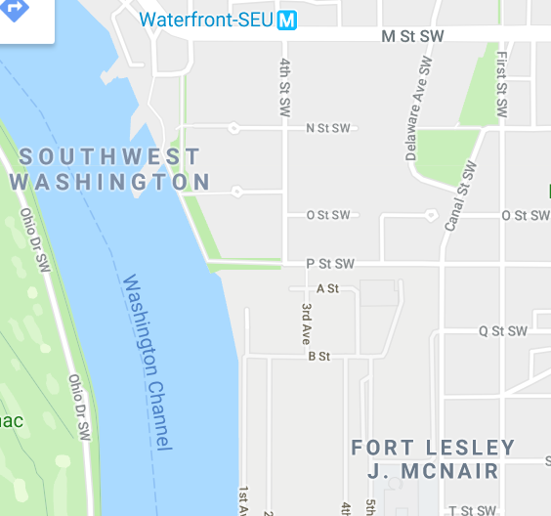
National Defense University
Fort Lesley J McNair, Washington D.C.
Welcome to the National Defense University. The University is located on the grounds of Fort Lesley J. McNair in Southwest Washington D.C. between the Anacostia River and the Washington Channel.
Travel Directions:
Via METRO: NDU is located about 1 mile from the Washington Metro’s Waterfront station on the Green Line. The station exit is in front of a Safeway store on the north side of M Street. Leaving the station, walk down 4th Street (S) three blocks until it ends and becomes P Street SW. Walk one block on P Street SW (E) to 2nd Street SW. Make a right on 2nd Street SW (S) following the brick wall on your right until you can make a right to enter Ft McNair Visitor Gate. Proceed through the gate until you get to the Security guard.
You will need to present a U.S. Government issued photo ID or passport.
You are subject to be searched.
Follow the Fort McNair Map to your destination.
Metro
Station
Ft McNair
Visitor Gate Entrance

Slide 2
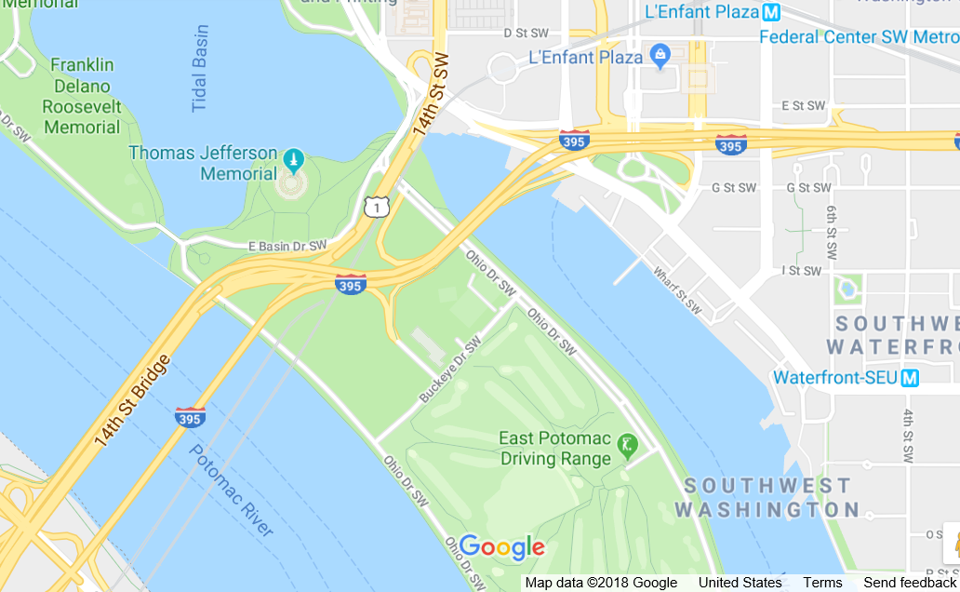
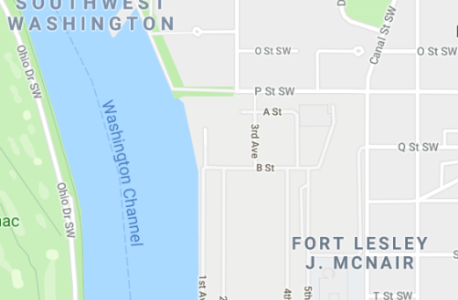
National Defense University
Fort Lesley J McNair, Washington D.C.
Travel Directions Continued:
From Arlington and points South and West (via 14th St Bridge): Follow I-395 North on the 14th Street Bridge (US Rte 1 North) across the Potomac River. Take the Maine Avenue exit on the right (just after the road dips down an curves to the left). At the foot of the ramp turn left. On Maine Avenue, bear right, staying at street level and continue on Maine Avenue until it curves left and becomes M Street SW. Turn right (S) on 4th Street SW and continue three blocks until it ends and becomes P Street SW. Continue one block on P Street SW (E) to 2nd Street SW. Make a right on 2nd Street SW (S) following the brick wall on your right until the first right you can make to enter Ft McNair Visitor Gate. Proceed through the gate until you get to the Security guard. Follow the map to designated parking.
You will need to present a U.S.
Government issued photo ID or
passport. Your vehicle is subject to be searched.
Take
Maine Ave Exit
Ft McNair
Visitor Gate Entrance

Slide 3
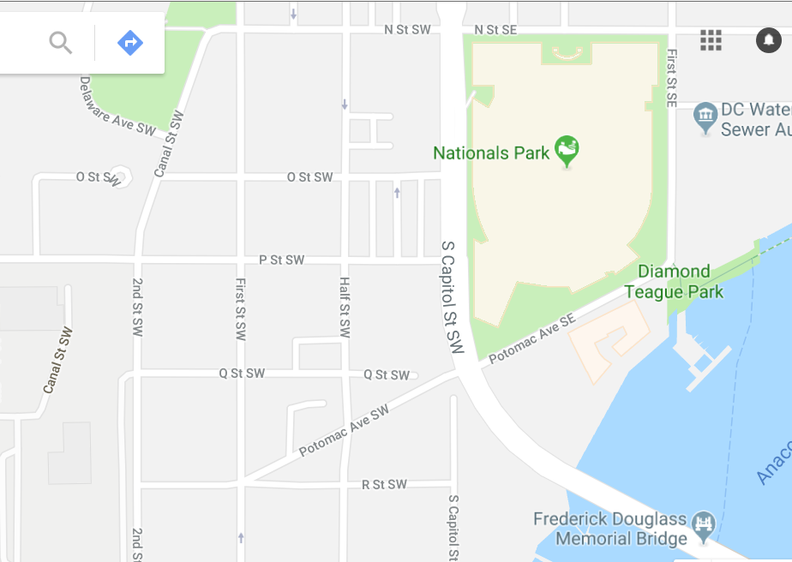
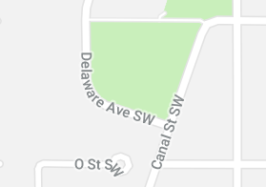
National Defense University
Fort Lesley J McNair, Washington D.C.
Travel Directions Continued:
From Alexandria or Anacostia (via Woodrow Wilson Bridge): Follow I-295 North to the South Capitol Street exit. Proceed across the South Capitol Street Bridge, staying to the right. Turn right on Potomac Ave SE to First Street SE. Make a left on to First Street SE staying in the left lane. Proceed one block to N Street SE and make a left. Proceed 3 blocks on N Street SE to S Capital Street SW and make a left. Ensure you are in the right lane. Go 2 blocks on S Capital Street SW heading south to P Street SW and make a right. Proceed 3 blocks on P Street SW to 2nd Street SW and then make a left. Go one block and then veer right onto Ft McNair Visitor gate entrance.
You will need to present a U.S.
Government issued photo ID or
passport. Your vehicle is subject to be searched.
Follow the Fort McNair
Map to your destination.
Baseball Stadium
Ft McNair
Visitor Gate Entrance

Slide 4
National Defense University
Fort Lesley J McNair, Washington D.C.
Travel Directions Continued:
From Maryland, Prince George’s County and Eastern Montgomery County: Follow the Capitol Beltway (I-495 or I-95) to the Baltimore-Washington (B-W) Parkway exit. Proceed Southbound on the B-W Parkway. As you near Washington, the B-W Parkway will become I-295 South; continue on I-295 to the Suitland Parkway exit. Exit at the Suitland Parkway and immediately exit on to I-295 Northbound. After joining I-295 North exit immediately at the South Capitol Street exit. Proceed across the South Capitol Street Bridge, staying to the right. Turn right on Potomac Ave SE to
First Street SE. Make a left on to First Street SE staying in the left lane. Proceed one block to N Street SE and make a left. Proceed 3 blocks on N Street SE to S Capital Street SW and make a left. Ensure you are in the right lane. Go 2 blocks on S Capital Street SW heading south to P Street SW and make a right. Proceed 3 blocks on P Street SW to 2nd Street SW and then make a left. Go one block and then veer right onto Ft McNair Visitor gate entrance.
You will need to present a U.S.
Government issued photo ID or
passport. Your vehicle is subject to be searched.
Follow the Fort McNair
Map to your destination.
Baseball Stadium
Ft McNair
Visitor Gate Entrance

Slide 5
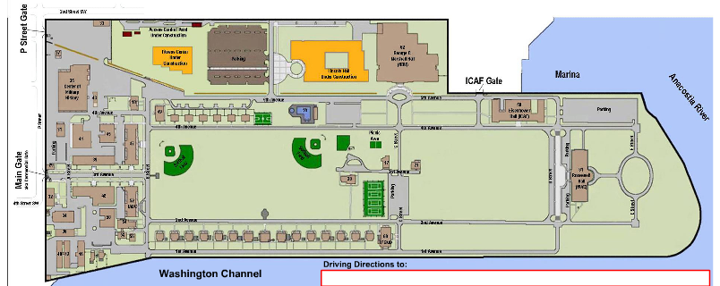
Ft McNair
National Defense University
Marshall Hall
(Bldg 62)
A
Parking
Q St SW
Visitor Gate Entrance
B
C
2nd St SW
Marshall Hall
(Bldg 62)
Parking Lot
Lincoln Hall
*
Marshall Hall
Parking Lot
Parking Lot
P St SW
Parking
Lot

